Slide 1

The Microsoft 365 Substrate And Its Use Cases
Presented By:
Lance Lingerfelt
M365 Specialist
Notes:
Microsoft 365 Substrate is a cloud-based platform that enables organizations to build modern digital workplaces and transform the way they work. This presentation will provide an overview of the many uses of Microsoft 365 Substrate and how it can benefit your business.

Slide 2

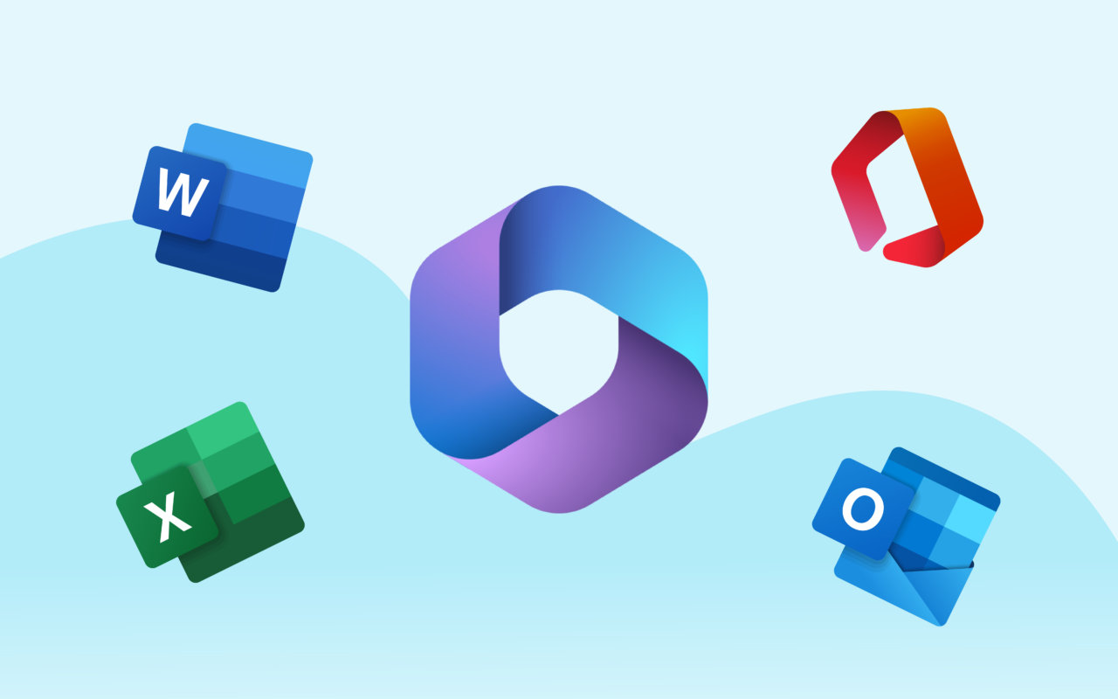
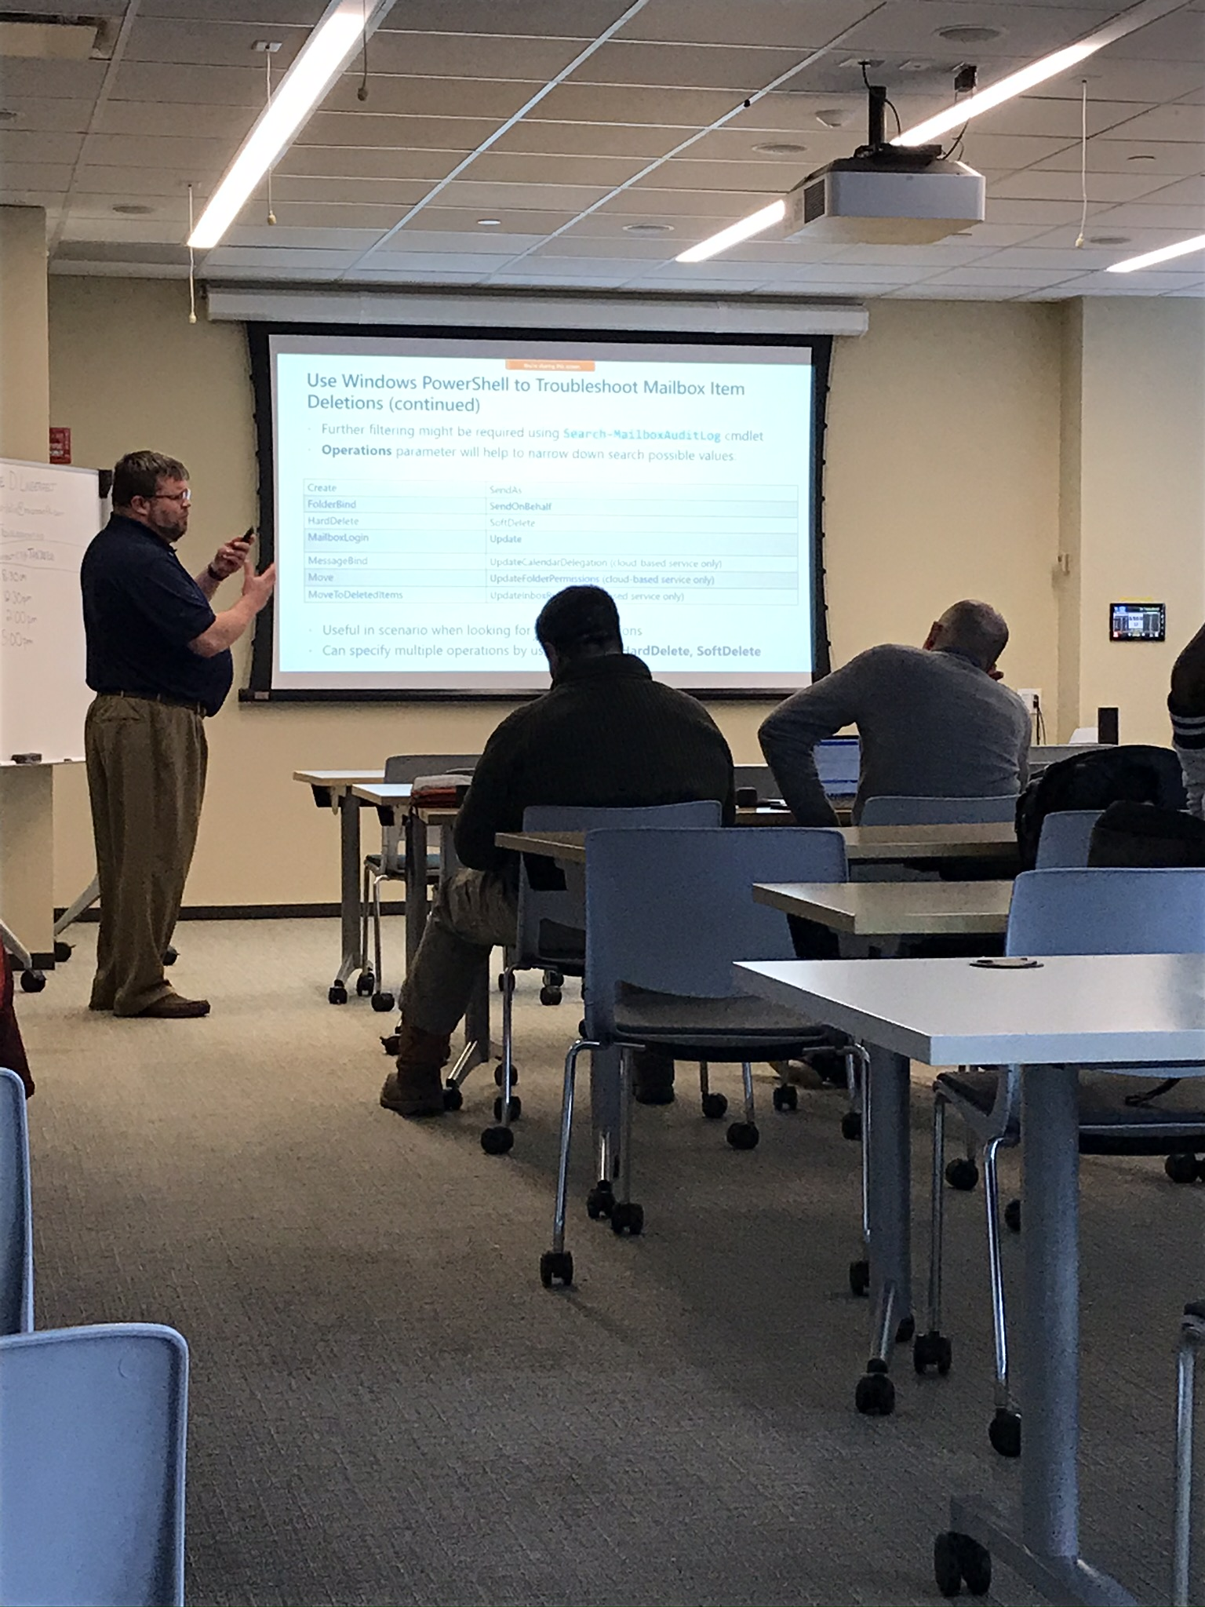














Lance Lingerfelt
Over 20+ years IT and MCT experience. M365, MCSE Certified
Worked for Microsoft and currently own my own company LDLNET LLC
Exchange/ AD / Entra / Teams SME, Security Architect, and Migration Specialist
Extensive PowerShell Scripting Experience
M365 Community Evangelist, Saxophonist, Company Owner, and Vehicle Enthusiast
https://itblog.ldlnet.net
https://www.linkedin.com/in/lance-lingerfelt-a27bb035

Slide 3

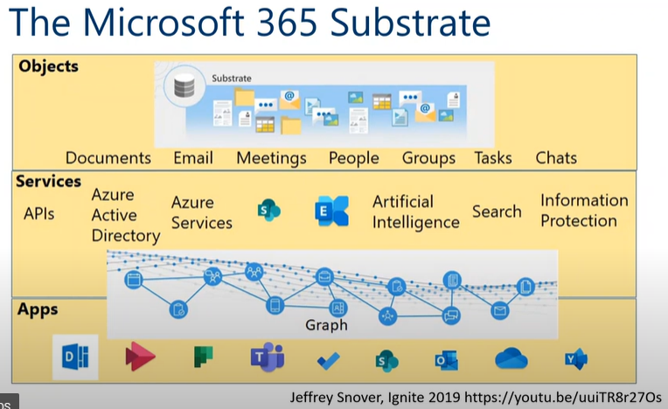
What is Microsoft 365 Substrate?
A cloud-based platform that provides a foundation for applications and services in Microsoft 365
Enables developers to build smart and connected applications and intelligent services
Provides a unified data substrate that connects Microsoft 365 applications and services
Notes:
Microsoft 365 Substrate is the foundation for applications and services in Microsoft 365. It provides a unified data substrate that connects Microsoft 365 applications and services, enabling developers to build smart and connected applications and intelligent services.

Slide 4

Use Case: Collaborative Workspaces
Provides a framework for building collaborative workspaces that integrate with Microsoft Teams and other Microsoft 365 applications
Enables employees to work together seamlessly across different locations
Provides a consistent user experience across different devices
Notes:
Microsoft 365 Substrate provides a framework for building collaborative workspaces that integrate with Microsoft Teams and other Microsoft 365 applications. This enables employees to work together seamlessly across different locations and provides a consistent user experience across different devices.

Slide 5

Use Case: Intelligent Search
Enables developers to build intelligent search experiences that can be embedded in custom applications
Leverages Microsoft Graph to provide personalized search results based on user context and behavior
Provides a modern search experience that is integrated with Microsoft 365 applications
Notes:
Microsoft 365 Substrate enables developers to build intelligent search experiences that can be embedded in custom applications. This leverages Microsoft Graph to provide personalized search results based on user context and behavior, and provides a modern search experience that is integrated with Microsoft 365 applications.

Slide 6

Use Case: Digital Process Automation
Enables developers to build custom workflows and automation solutions that integrate with Microsoft 365 applications
Provides a low-code framework for building custom business applications
Automates manual processes and improves efficiency
Notes:
Microsoft 365 Substrate enables developers to build custom workflows and automation solutions that integrate with Microsoft 365 applications. This provides a low-code framework for building custom business applications, automates manual processes, and improves efficiency.

Slide 7

Use Case: Data Insights
Provides a unified data substrate that connects Microsoft 365 applications and services
Enables developers to build analytics solutions that leverage Microsoft Graph data
Provides insights into user behavior and usage patterns
Notes:
Microsoft 365 Substrate provides a unified data substrate that connects Microsoft 365 applications and services. This enables developers to build analytics solutions that leverage Microsoft Graph data, providing insights into user behavior and usage patterns.

Slide 8

Use Case: AI and Machine Learning
Provides a platform for building AI and machine learning models that leverage Microsoft Graph data
Enables developers to build intelligent applications and services that can interact with users in natural language
Integrates with Azure Machine Learning for advanced analytics
Notes:
Microsoft 365 Substrate provides a platform for building AI and machine learning models that leverage Microsoft Graph data. This enables developers to build intelligent applications and services that can interact with users in natural language, and integrates with Azure Machine Learning for advanced analytics.

Slide 9

Benefits of Microsoft 365 Substrate
Enables developers to build smart and connected applications and intelligent services
Provides a unified data substrate that connects Microsoft 365 applications and services
Increases efficiency and productivity through automation and workflow optimization
Notes:
Microsoft 365 Substrate enables developers to build smart and connected applications and intelligent services, and provides a unified data substrate that connects Microsoft 365 applications and services. This increases efficiency and productivity through automation and workflow optimization.

Slide 10

Getting Started with Microsoft 365 Substrate
Start by exploring the Microsoft 365 Substrate documentation
Join the Microsoft 365 Developer Program to access exclusive resources and support
Use the Microsoft 365 Substrate SDK to build custom applications and services
Notes:
Getting started with Microsoft 365 Substrate is easy. Start by exploring the Microsoft 365 Substrate documentation, join the Microsoft 365 Developer Program to access exclusive resources and support, and use the Microsoft 365 Substrate SDK to build custom applications and services.

Slide 11

Thank You!
Notes:
Thank you for taking the time to learn about the many uses of Microsoft 365 Substrate. Visit the Microsoft 365 Developer Center to learn more and start building today!

